Slide 1
INTERNATIONAL ECONOMIS
Course code- ECONA306
Class- BA 3rd year
Discipline Specific Elective
Session -2022-23
Gopal Bhardwaj
Assistant Professor
Dept. of Economics
Gopal Bhardwaj
Assistant Professor
Dept. of Economics

Slide 2
Chapter 2: Absolute Advantage
An Introduction to International Economics: New Perspectives on the World Economy

Slide 3
Introduction
This chapter makes a first step in helping you to answer these questions
  Why does a country export or import a particular good or service?
Historically, the initial explanation for patterns of trade lay with the concept of absolute advantage.
Subsequently, this concept was replaced with the more powerful concept of comparative advantage.
One of the most fundamental principles of economics is gains from trade.
Two main explanations of comparative advantage:
  Ricardian model
  Heckscher-Ohlin model

Slide 4
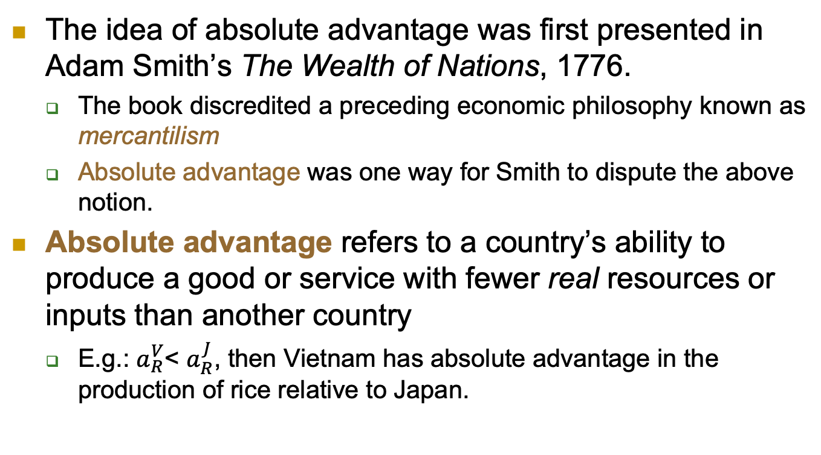
Defining Absolute Advantage
The idea of absolute advantage was first presented in Adam Smith’s The Wealth of Nations, 1776.
  The book discredited a preceding economic philosophy known as mercantilism
  Absolute advantage was one way for Smith to dispute the above notion.
Absolute advantage refers to a country’s ability to produce a good or service with fewer real resources or inputs than another country
  E.g.: $a_{R}^{V}$<$a_{R}^{J}$, then Vietnam has absolute advantage in the production of rice relative to Japan.

Slide 5
Absolute Advantage: limitations
The principle of absolute advantage is a policy suggestion that countries should import goods from other countries where they are produced more efficiently.
However, patterns of absolute advantage are neither necessary nor sufficient conditions for countries to either export or import a good or service (which is determined by comparative advantage to be explored in Chapters 3 and 4)

Slide 6
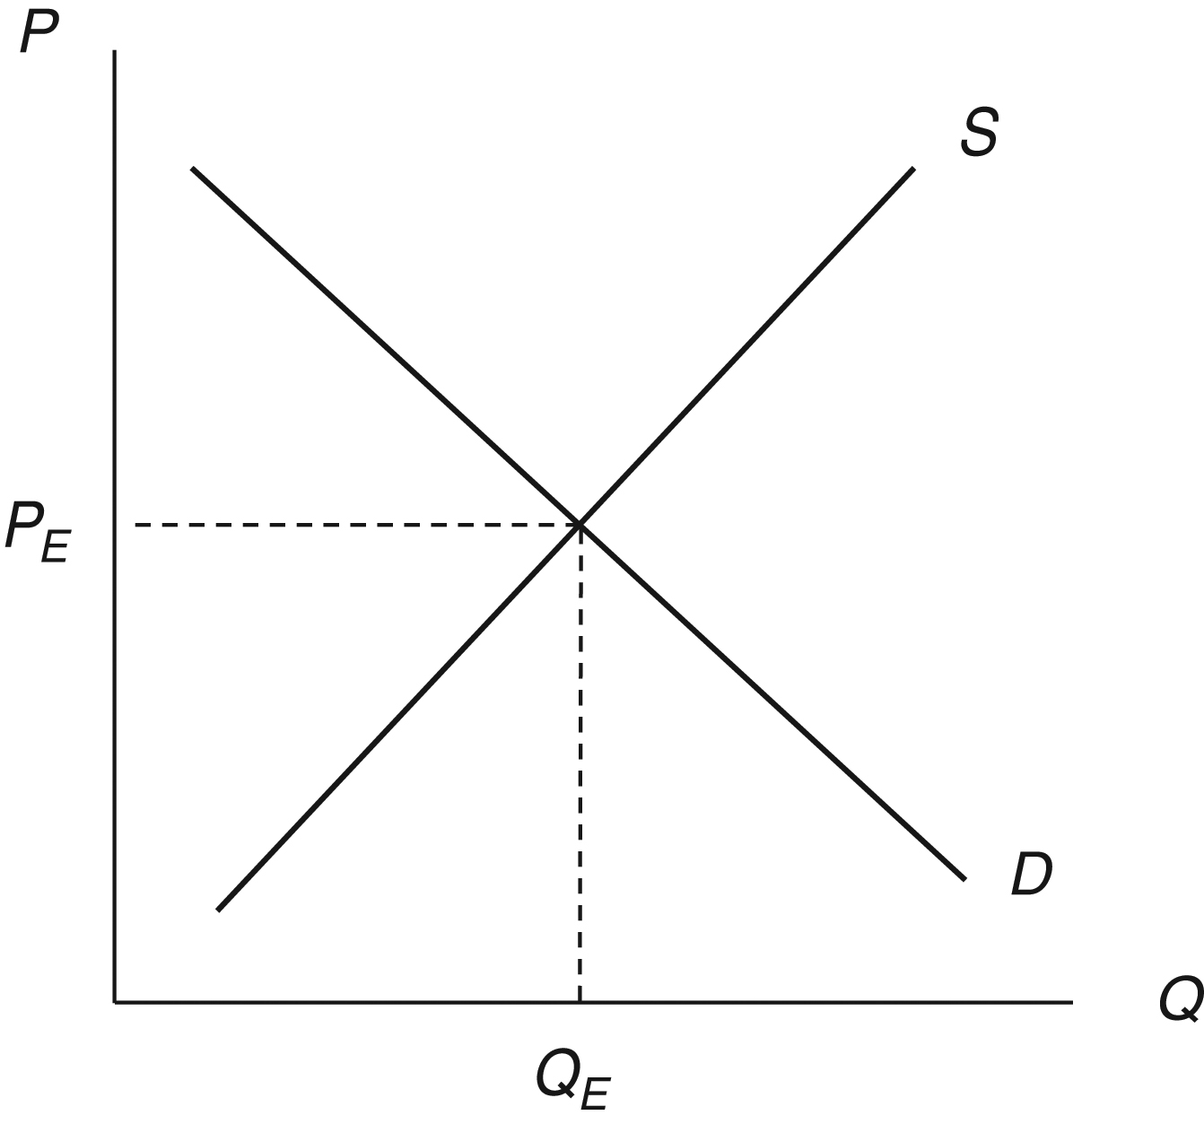
Review of Supply and Demand
Supply curve is upward sloping—firms supply more rice to the market as the price increases
Changes in price are represented in the diagram by movements along the supply curve—changes in quantity supplied
Changes in supply:
  Reductions in input prices and improvements in technology shift the supply curve to the right
  Increases in input prices and technology setbacks shift the supply curve to the left
Figure 2.5. A Domestic Rice Market

Slide 7
Review of Supply and Demand
Demand curve is downward sloping—consumers demand less rice from market as price increases
  Changes in price are represented by movements along the demand curve—changes in quantity demanded
Changes in demand: (caused by incomes and preferences)
  Increases shift demand curve to right
  Decreases shift demand curve to left
Figure 2.5. A Domestic Rice Market

Slide 8
Review of Supply and Demand
Intersection of supply and demand curves determines the equilibrium in the domestic rice market
Any shifts will change equilibrium price and quantity for rice by shifting the demand or supply curves.
Figure 2.5. A Domestic Rice Market

Slide 9
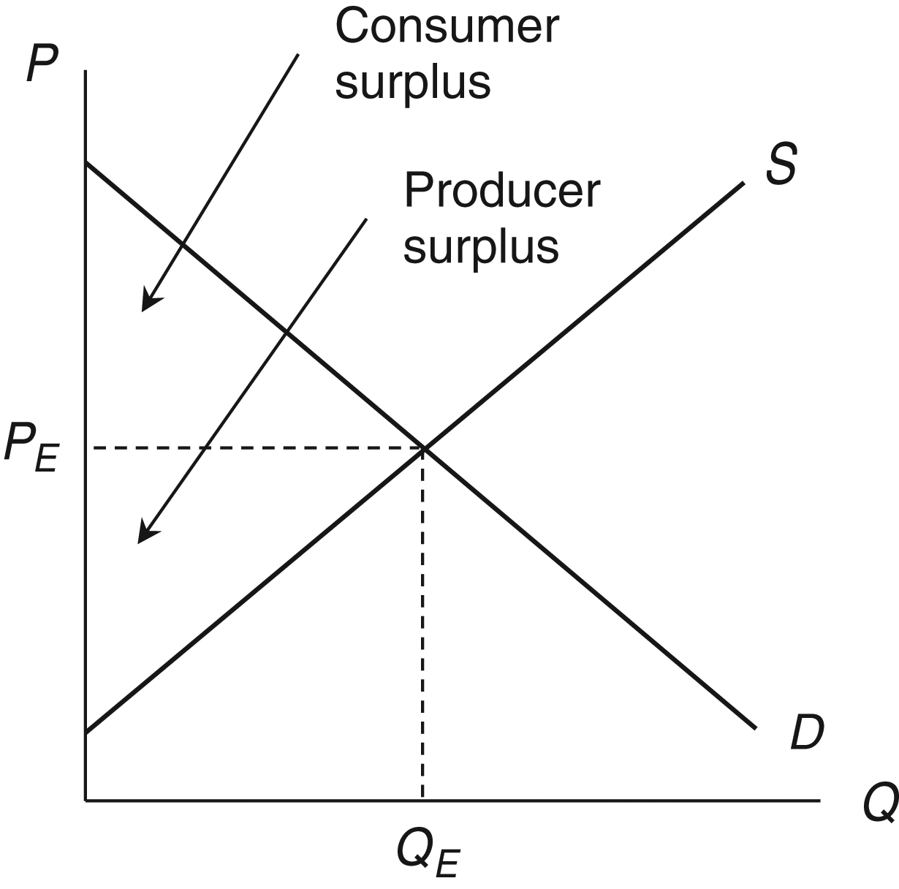
Review of Supply and Demand
Figure 2.6 Consumer and producer surplus

Slide 10
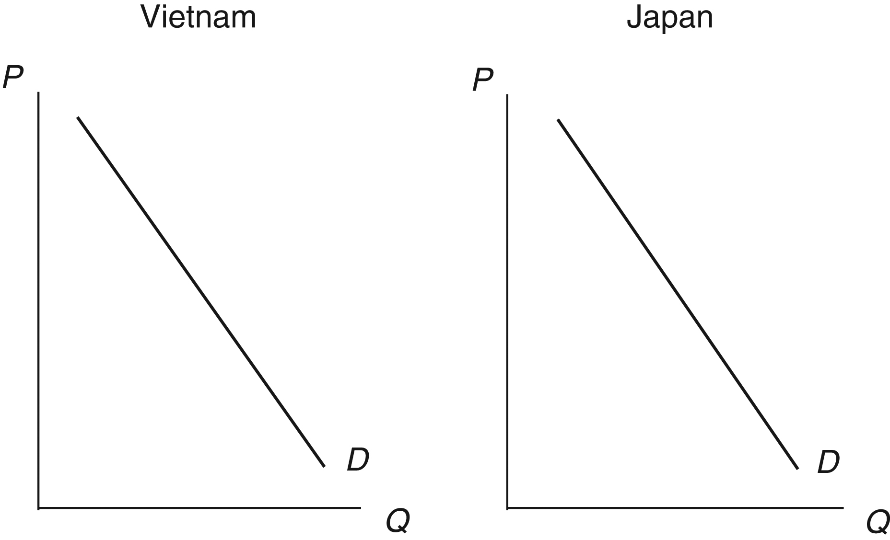
Absolute Advantage in Supply and Demand
Rice is produced in both Vietnam and Japan
Assume demand conditions are exactly the same in both countries
  Implies demand curves for rice in the two countries are exactly the same (Figure 2.1)
Figure 2.1. Demand for Rice in Vietnam and Japan

Slide 11
Autarky Price
Since no trade is involved between Vietnam and Japan
  These two prices are known in international economics as autarky prices
    Autarky is a situation in which a country has no economic relationships with other countries
    Figure 2.2 depicts a situation in which autarky price of rice is lower in Vietnam than in Japan

Slide 12
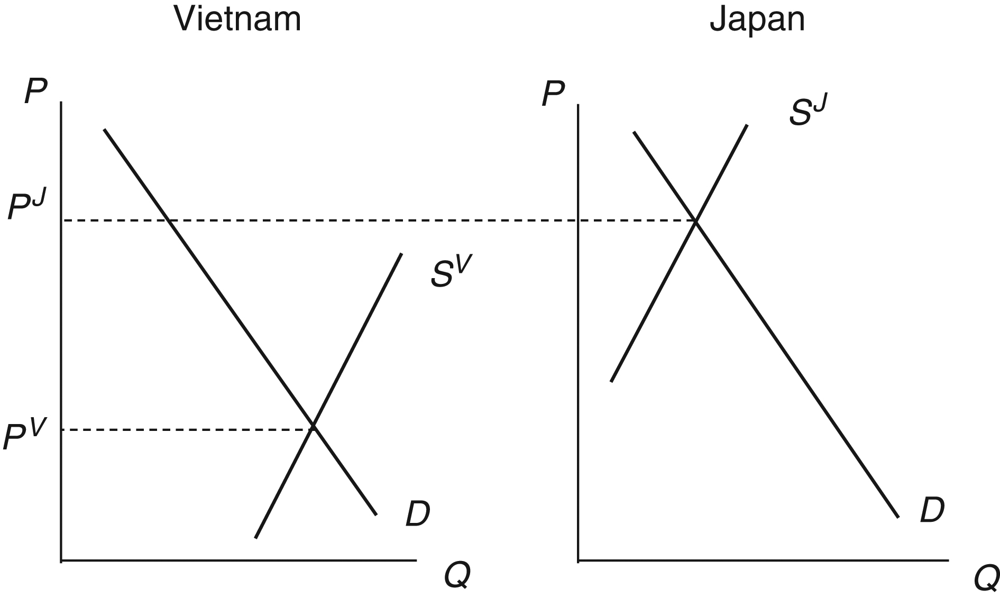
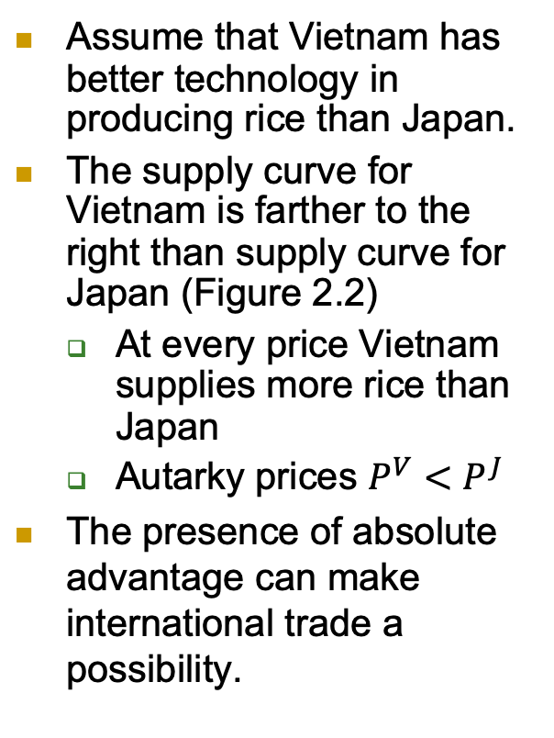
Absolute Advantage in Supply and Demand
Assume that Vietnam has better technology in producing rice than Japan.
The supply curve for Vietnam is farther to the right than supply curve for Japan (Figure 2.2)
  At every price Vietnam supplies more rice than Japan
  Autarky prices $P^{V}<P^{J}$
The presence of absolute advantage can make international trade a possibility.
Autarky prices
Figure 2.2. Absolute Advantage in the Rice Market

Slide 13
International Trade
Absolute advantage implies a potential pattern of trade
  If the two countries forgo autarky and begin to trade
    World price of rice will lie somewhere between the two autarky prices, or
      P^{V} < P^{W} < P^{J}
    This situation is depicted in Figure 2.3

Slide 14
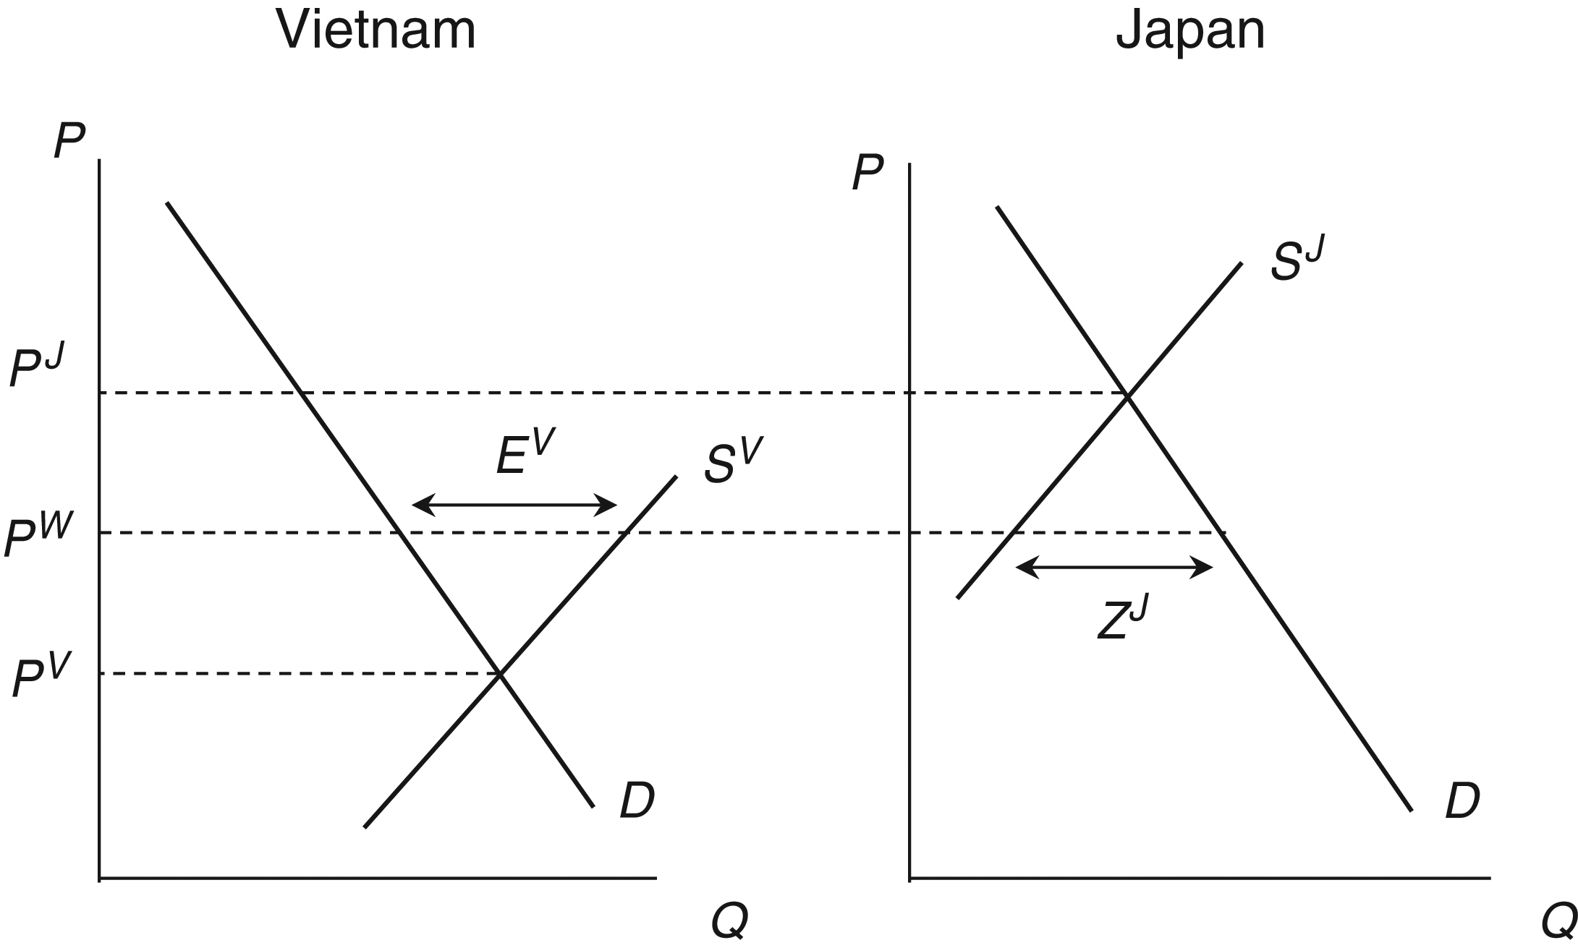
Absolute Advantage in Supply and Demand
Vietnam’s export of rice
Price of rice decreases in Japan
Price of rice increases in Vietnam
Japan’s import of rice
Figure 2.3 Trade in the rice market

Slide 15
Summary So Far
Differences in supply conditions among countries rise to complementary patterns of absolute advantage
These patterns of absolute advantage make possible complementary patterns of international trade

Slide 16
Gains from Trade
Given a pattern of absolute advantage, it is possible for a country to give up autarky in favor of importing or exporting
  Japan can import rice, and Vietnam can export rice
But should a country actually do this?
To answer this question from the standard economic point of view using consumer surplus and producer surplus

Slide 17
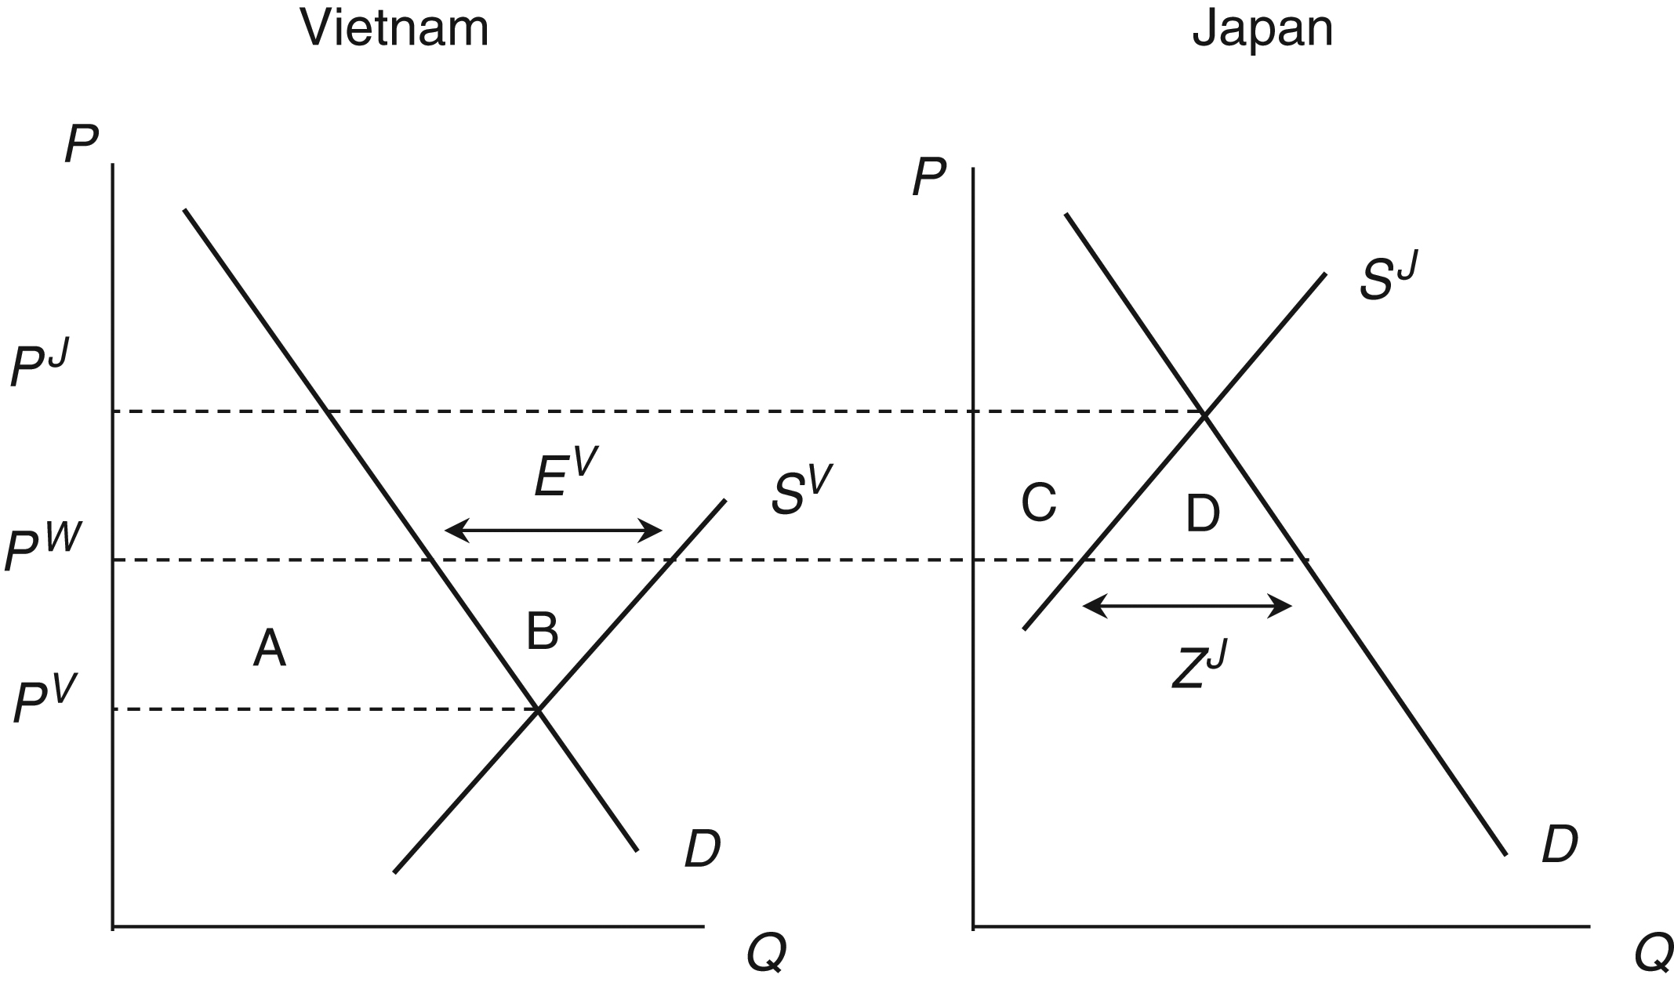
For Vietnam:
  An increase in producer surplus of area A+B
  A decrease in consumer surplus of area A
  → There is a net welfare increase of area B
For Japan:
  An increase in consumer surplus of area C+D
  A decrease in producer surplus of area C
  → There is a net welfare increase of area D
Figure 2.4. Gains from Trade in the Rice Market

Slide 18
Gains from Trade
Moving from autarky to either importing or exporting involves a net increase in welfare for the country involved
  Known as gains from trade
Many popular writings on the world economy suggest trade relationships are a win-lose proposition for the countries involved
  The gains from trade idea, however, tells us that trade can be mutually beneficial to countries involved

Slide 19
Limitations
The notion of absolute advantage is useful for understanding international trade both as a principle and in the context of the supply and demand framework.
It is also useful to understand that trade can improve overall welfare for countries involved.
It has limits:
  Suggests the possibility that a country could not have an absolute advantage in anything, and would have nothing to export at all
  This is unlikely

Slide 20
Limitations
The notion of the gains from trade also has its limits
  Suggests that countries as a whole mutually gain from trade
  Does not suggest, however, that everyone within a country will gain from trade
    Producers of rice in Japan lose from trade, and consumers of rice in Vietnam lose from trade

